Slide 1

SFA based self-localization using natural landmarks
Master Thesis - Kaushik Karanam
Frankfurt University of Applied Sciences
Notes:
1

Slide 2
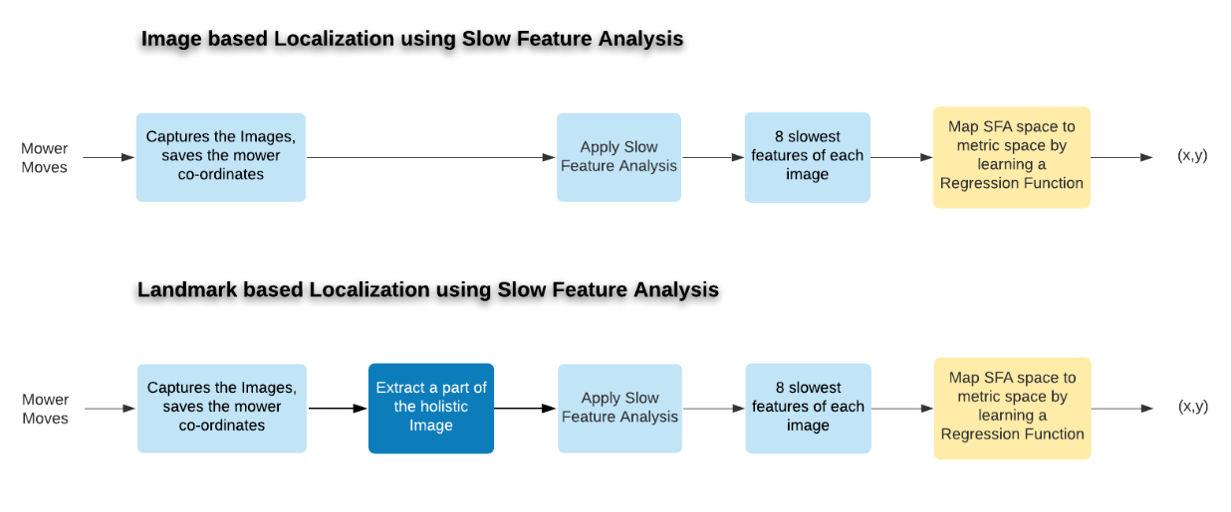
Project overview

Slide 3
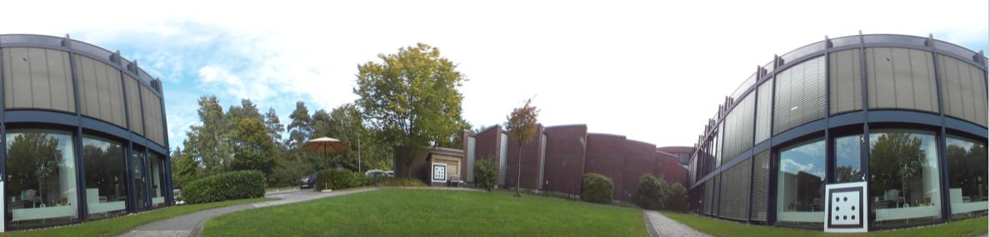
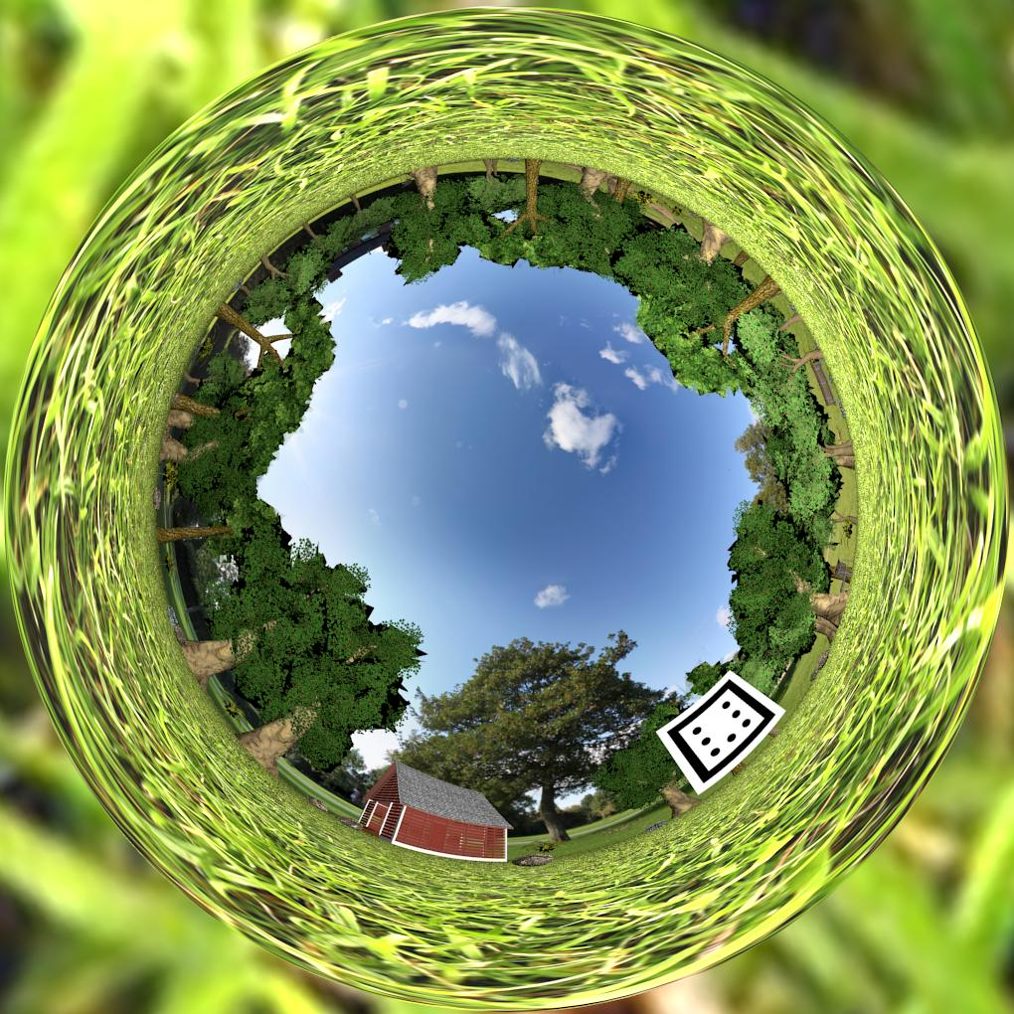
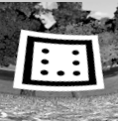
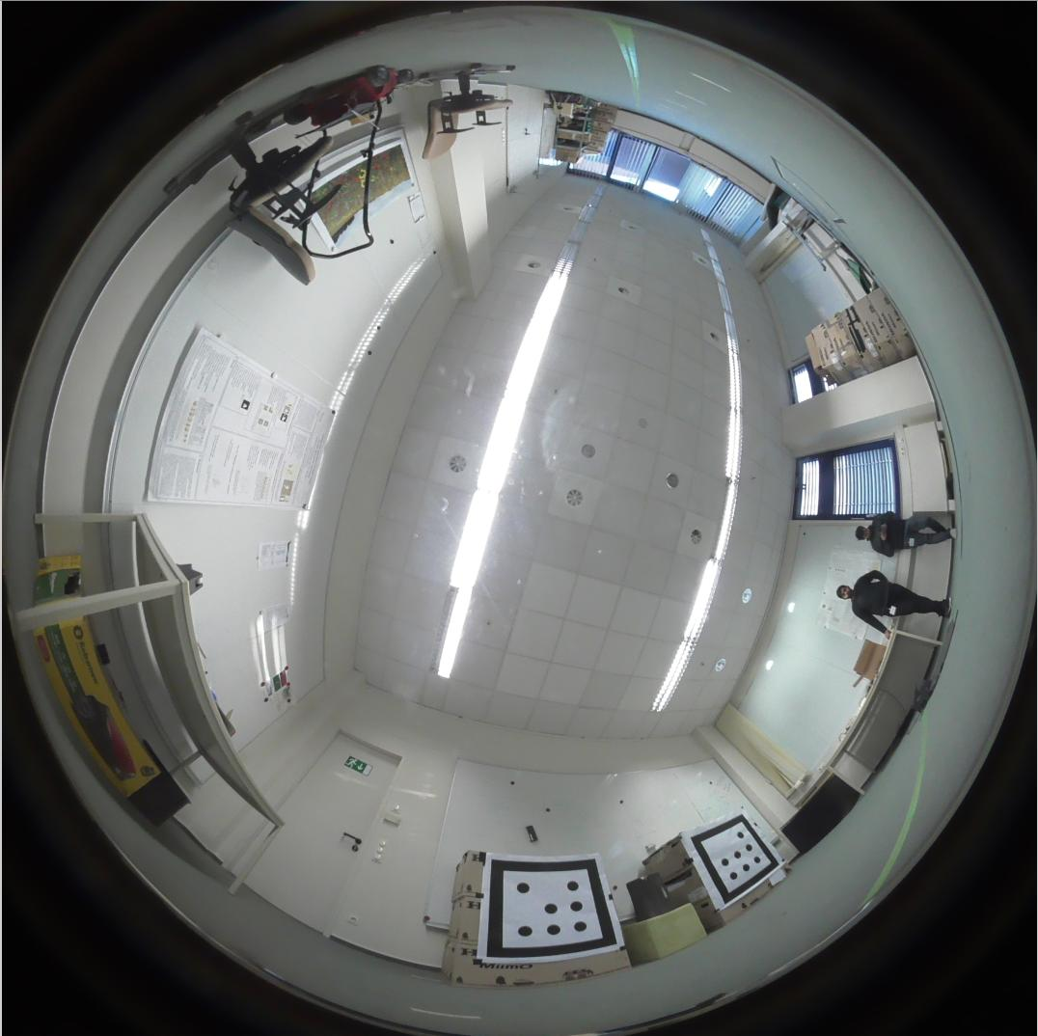
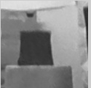
Holistic view
Simulated Environment
Natural Land marker ( current Experiment)
Images from different scenarios
Notes:
<number>

Slide 4
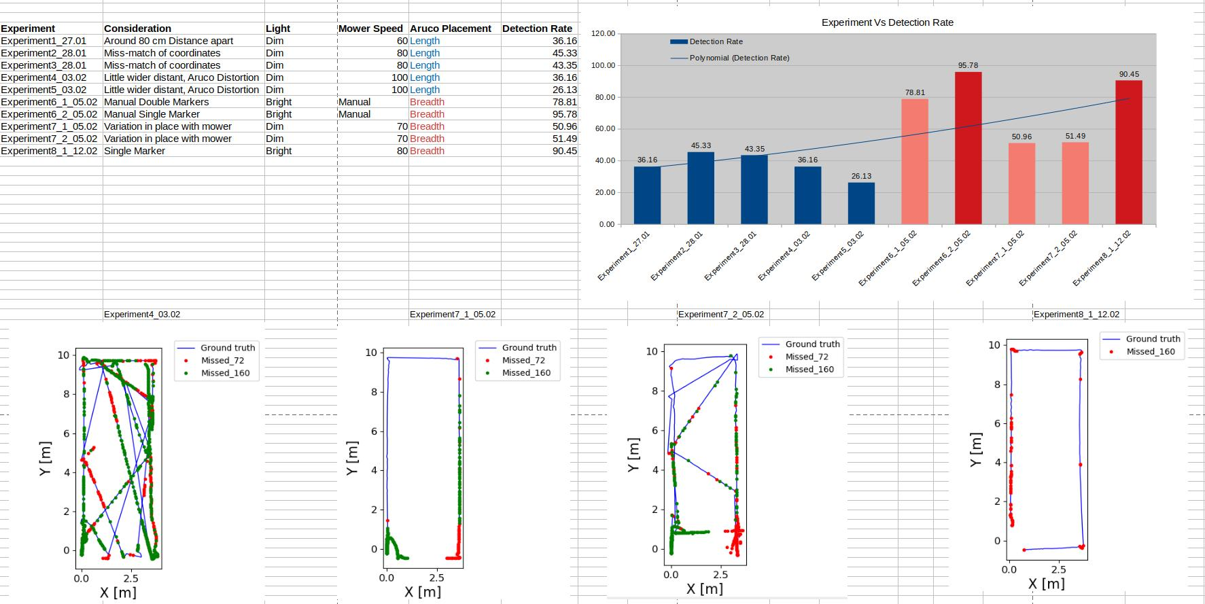
Notes:
<number>

Slide 5
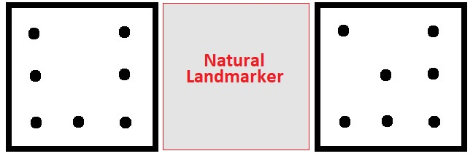
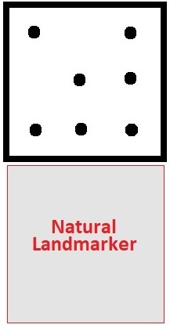
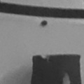
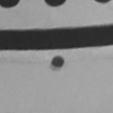
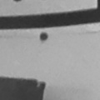
Ideas to capture the natural land-marker
Using two Markers
Using single Marker
Height = 120 , Width = 120
Dependency Issues of Two Markers

Slide 6
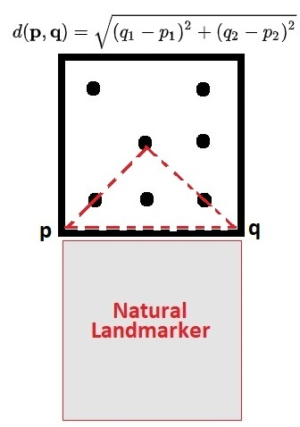
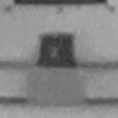
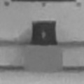
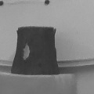
New Strategy of image extraction
Instead of keeping the extraction dimensions constant, we keep varying the dimensions of image extractions based on the size of the Aruco detected.

Slide 7
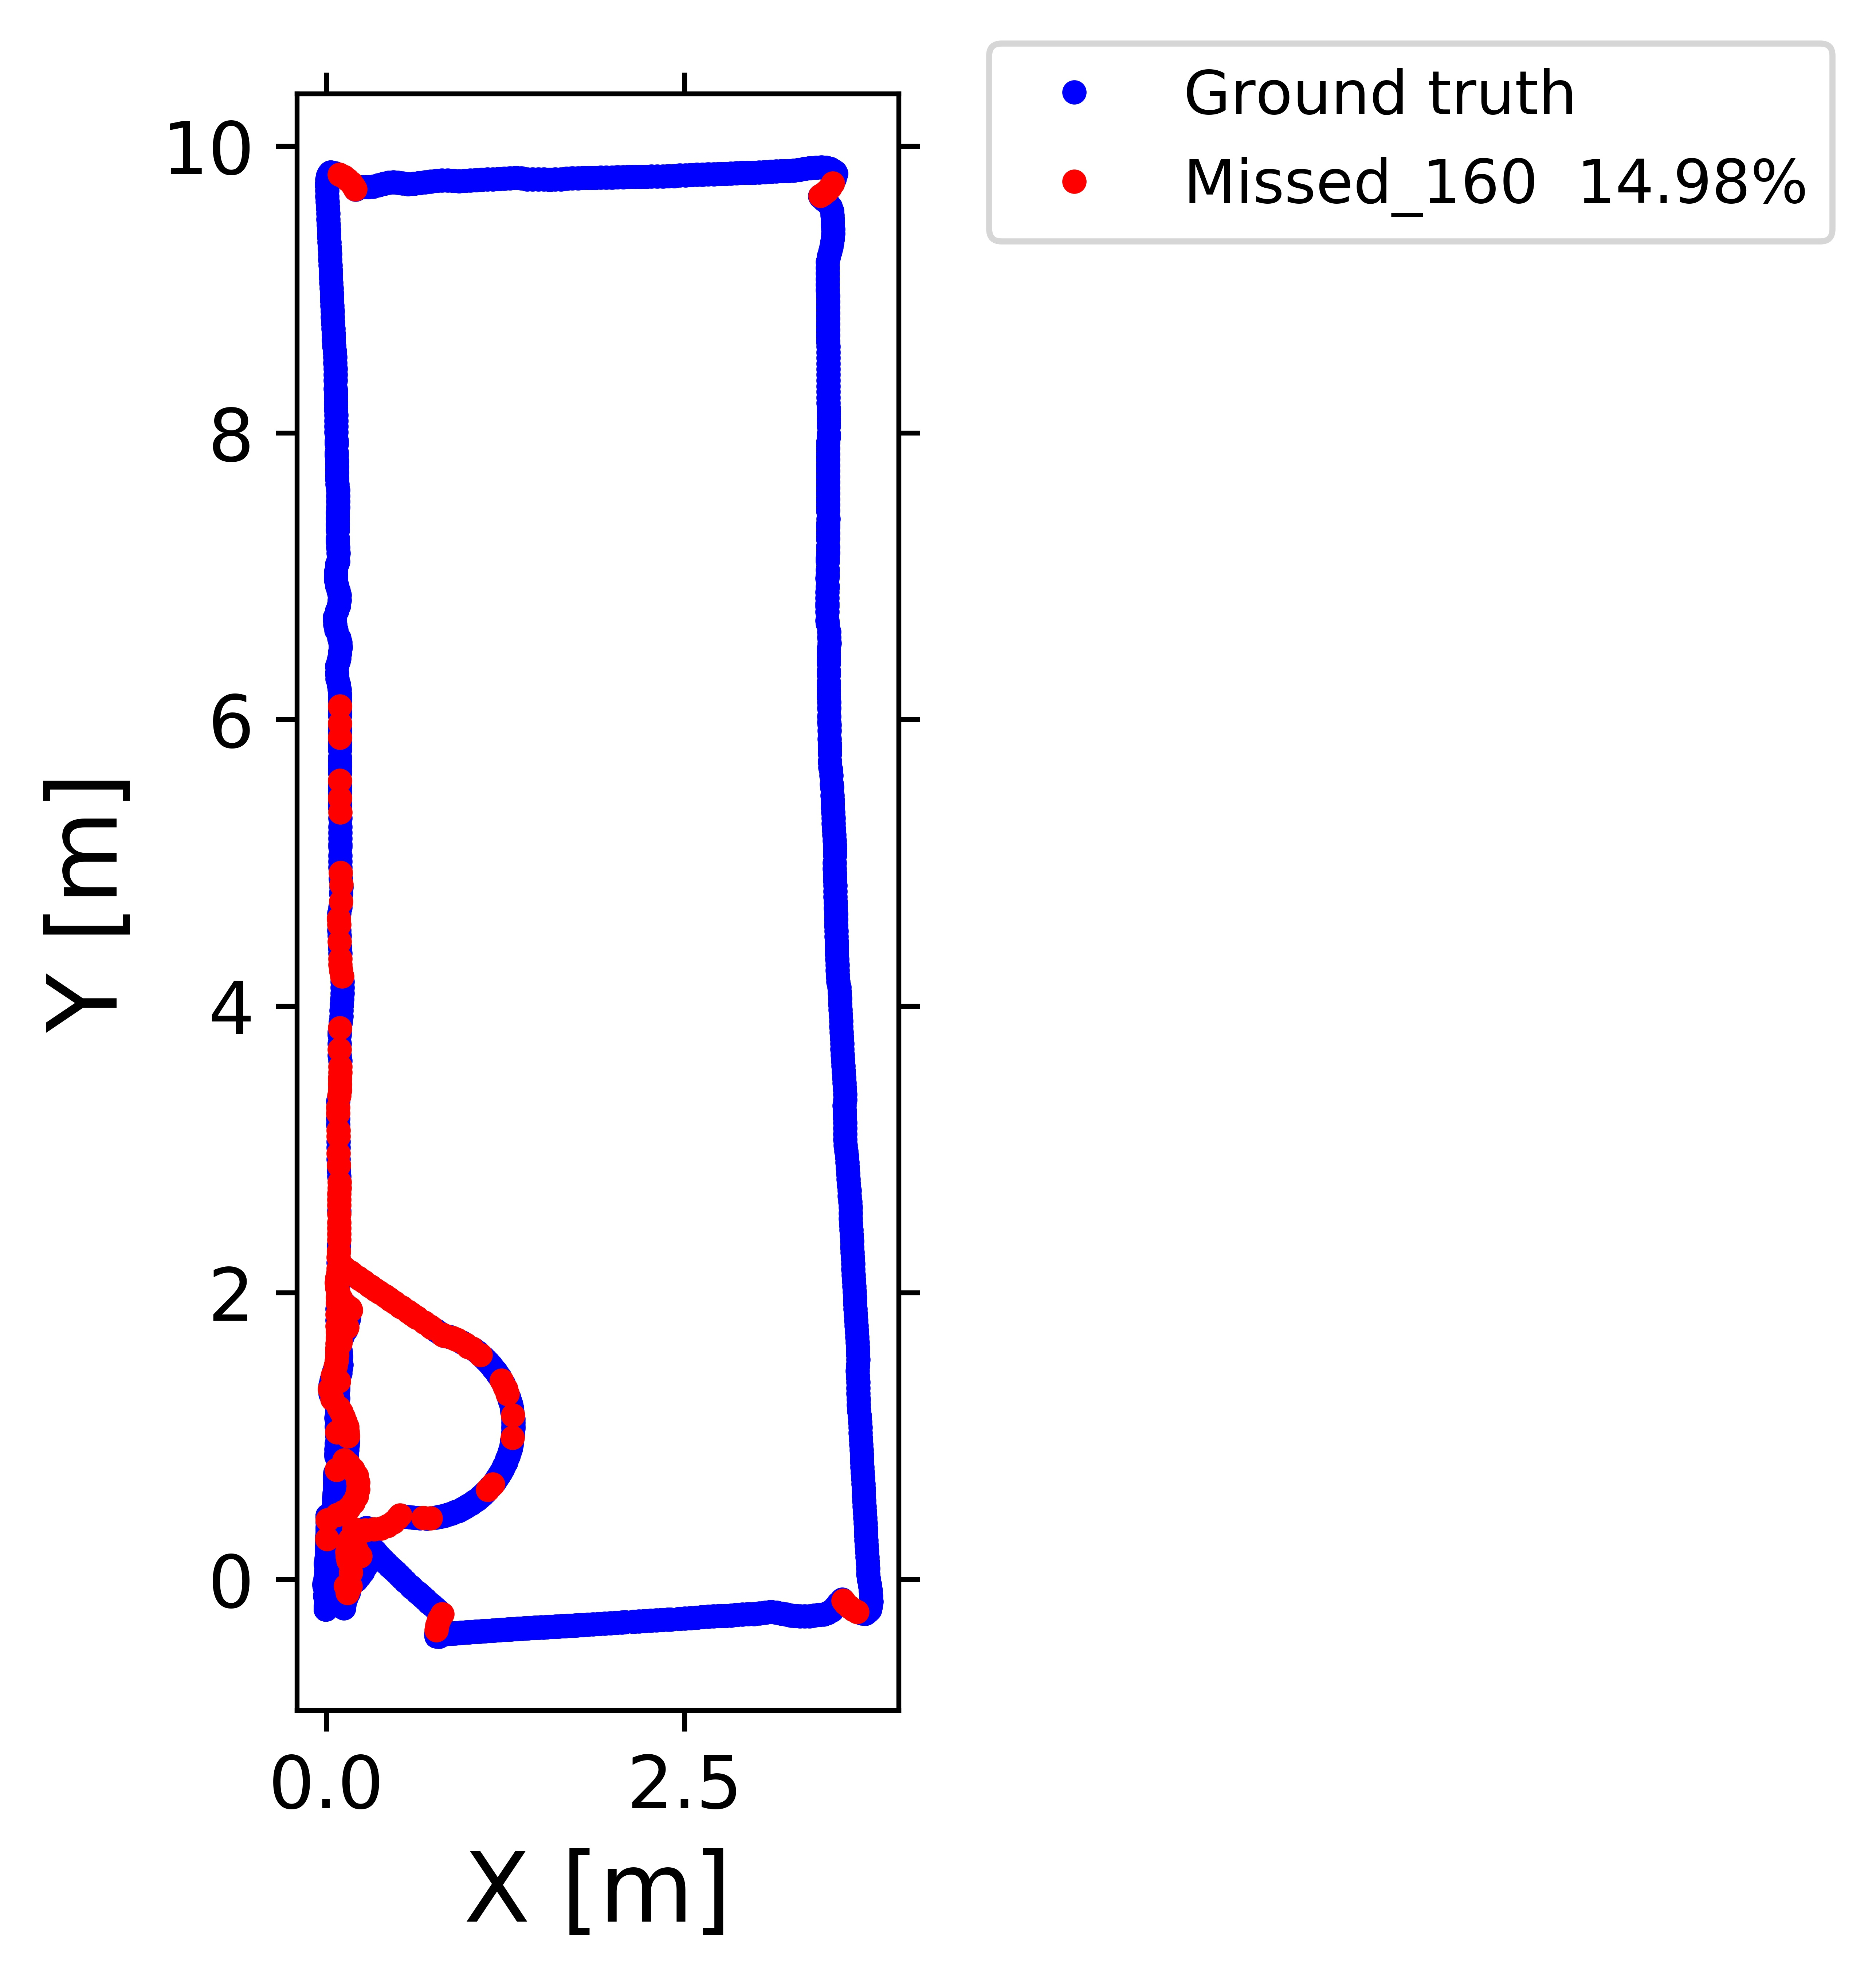
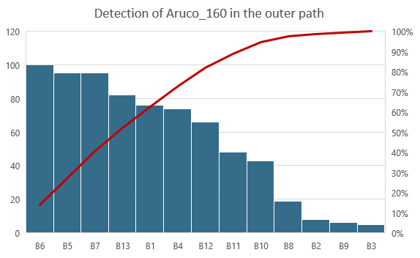
Detection rate of single marker

Slide 8
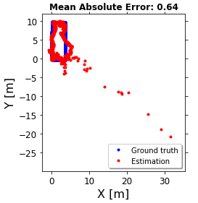
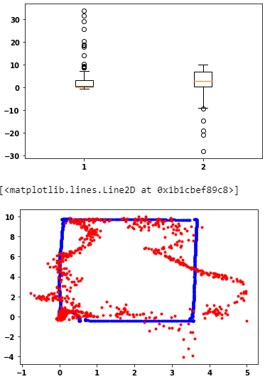
Single Aruco marker results
Evaluation using Linear Regression
Outliers removal

Slide 9
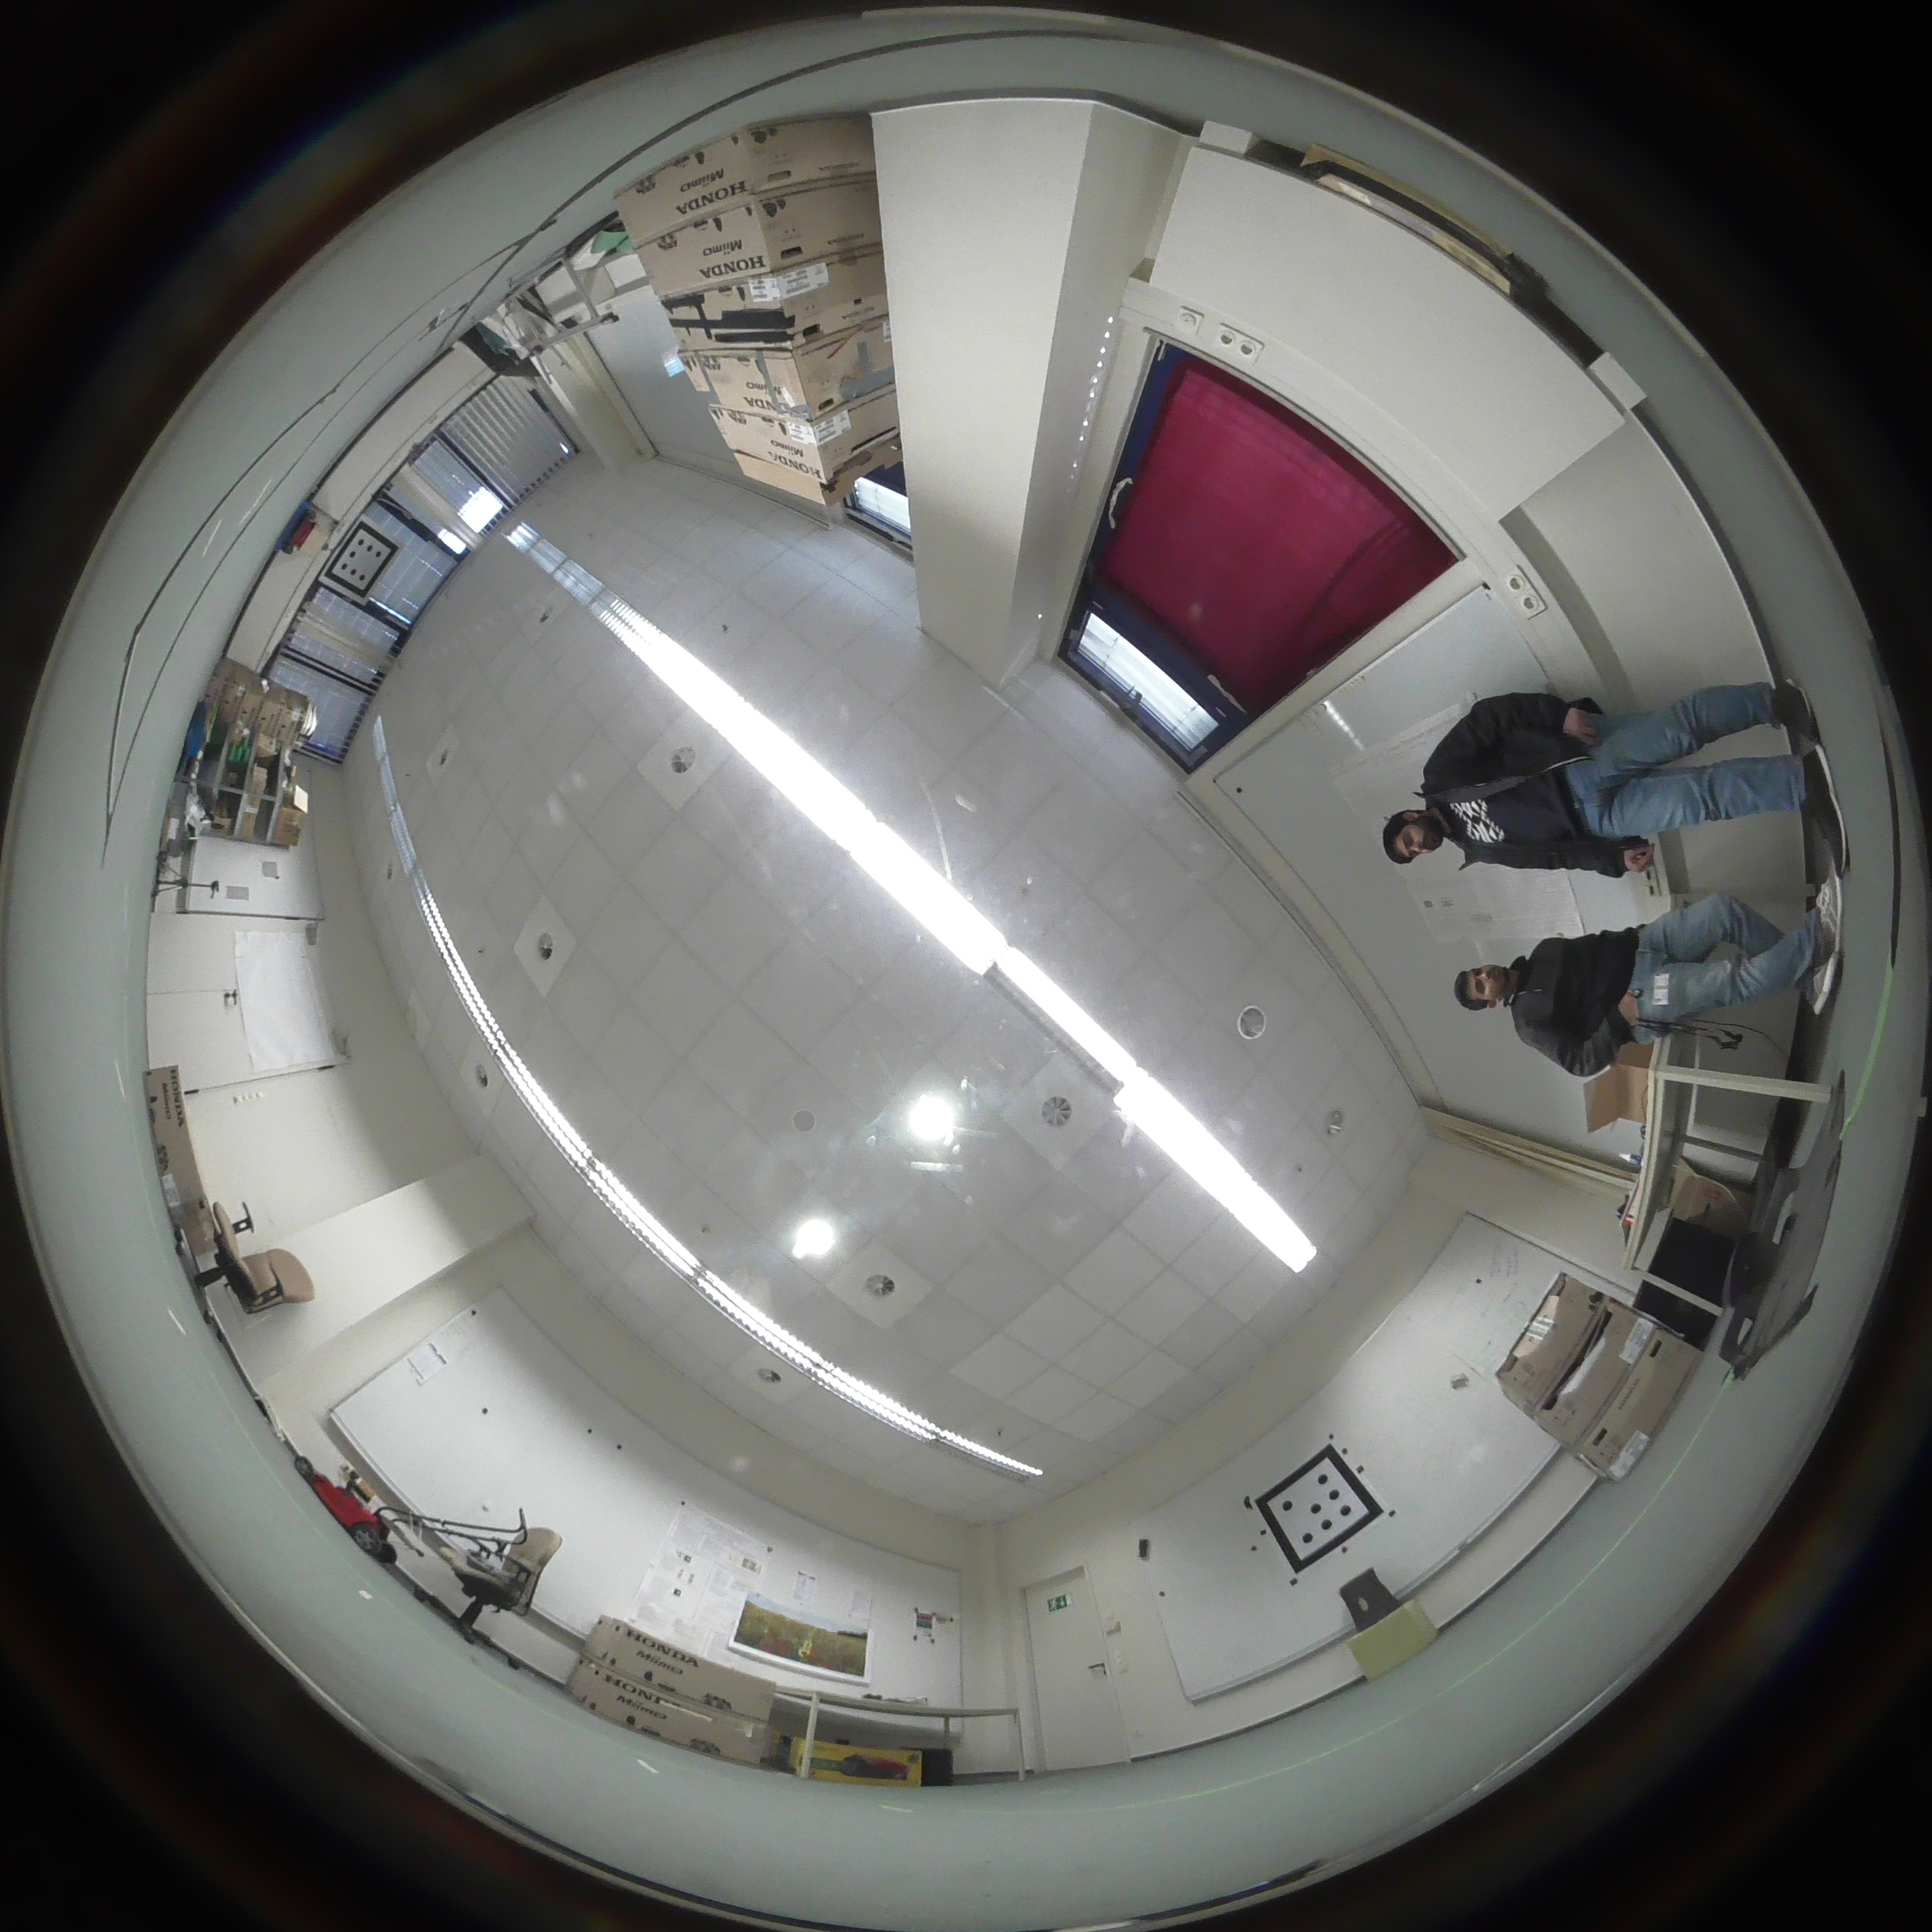
Multiple land-markers

Slide 10
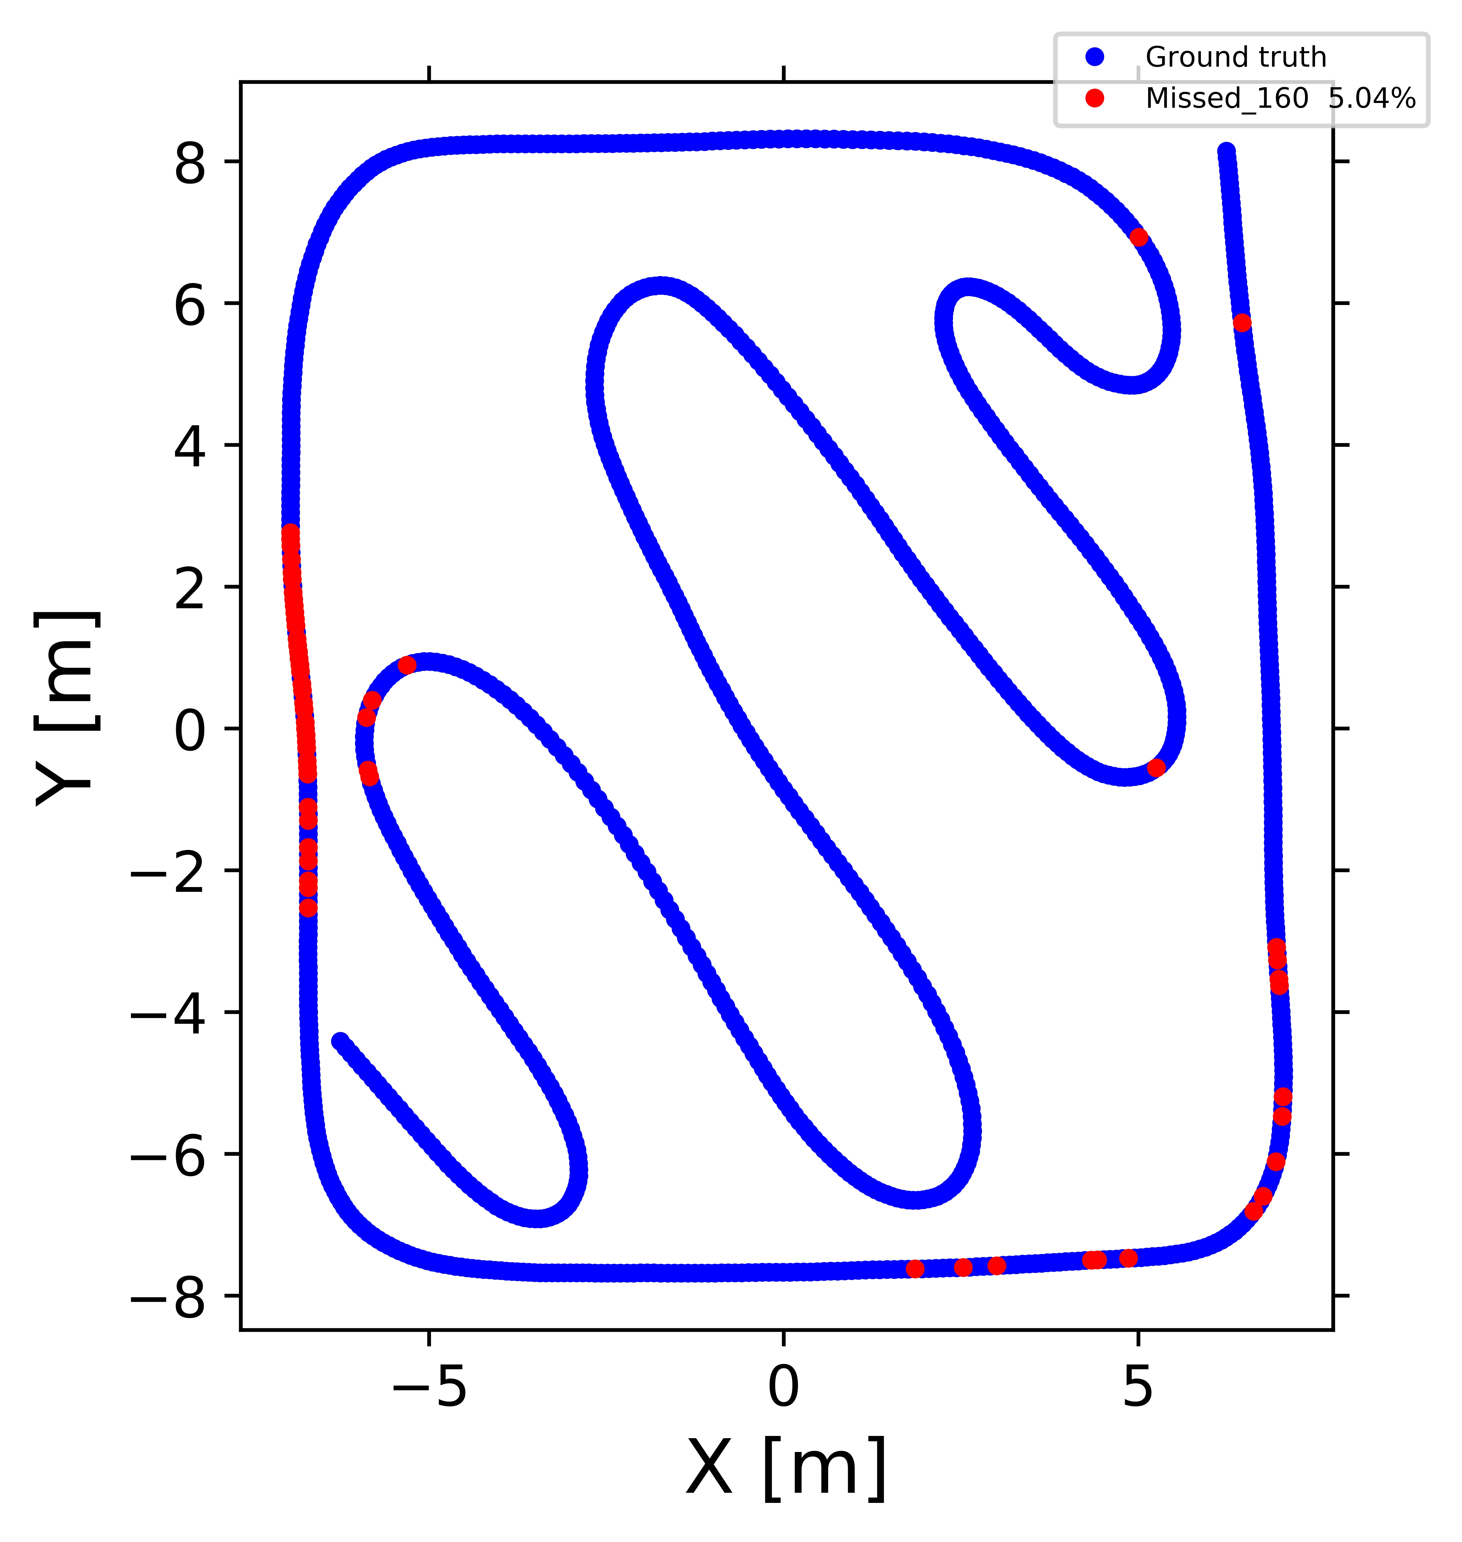
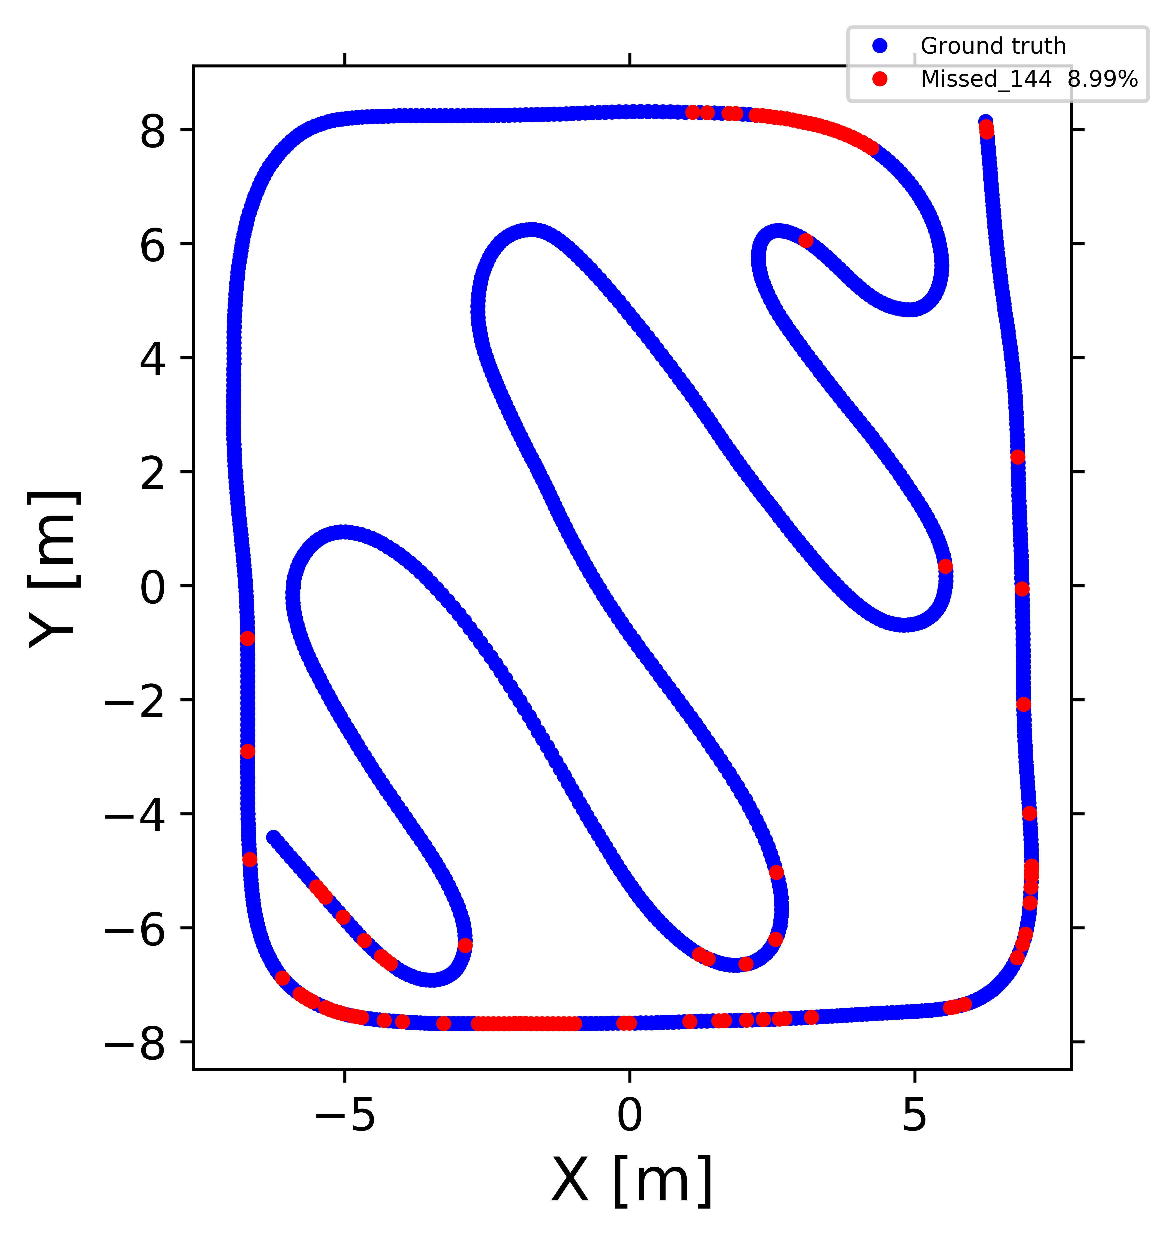
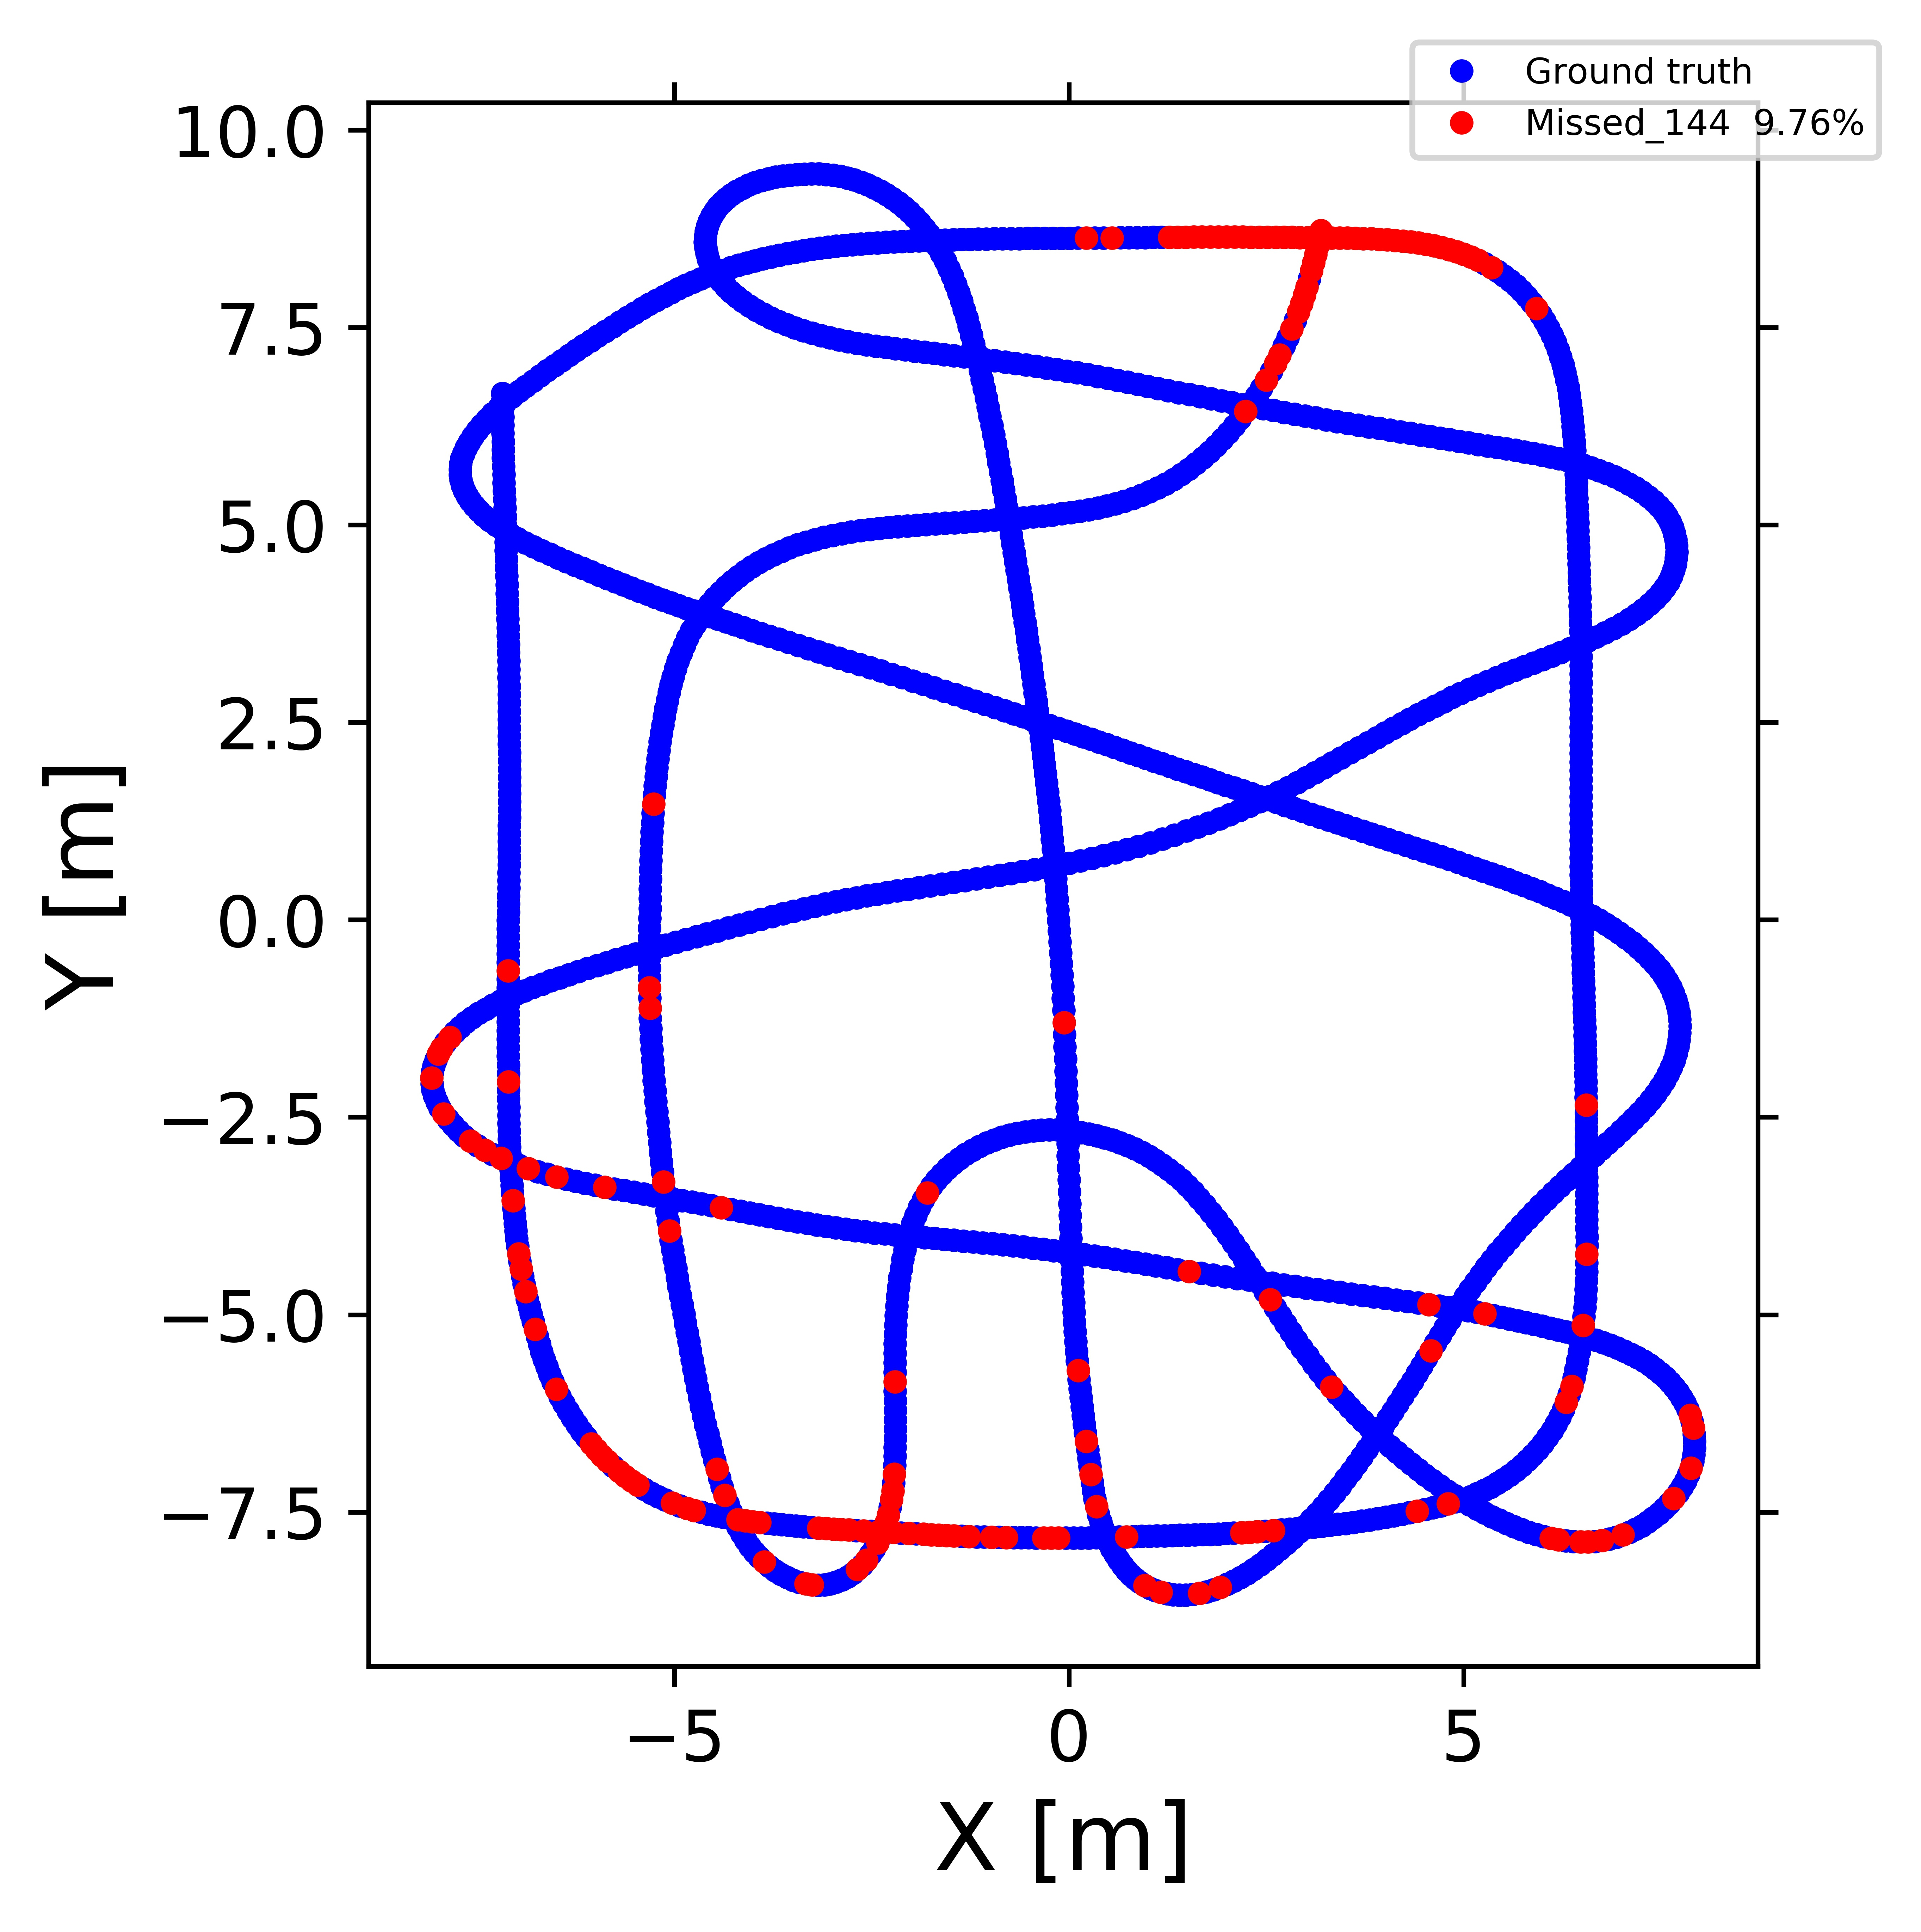
Test Data
Train Data
Simulated images total marker detection rate (indoor)
160
160
144
144

Slide 11
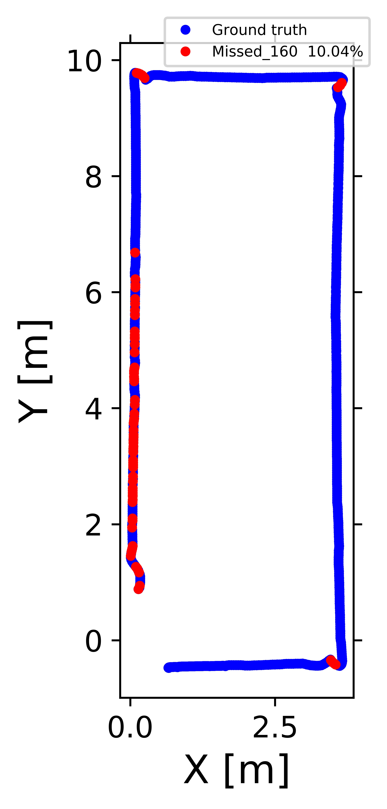
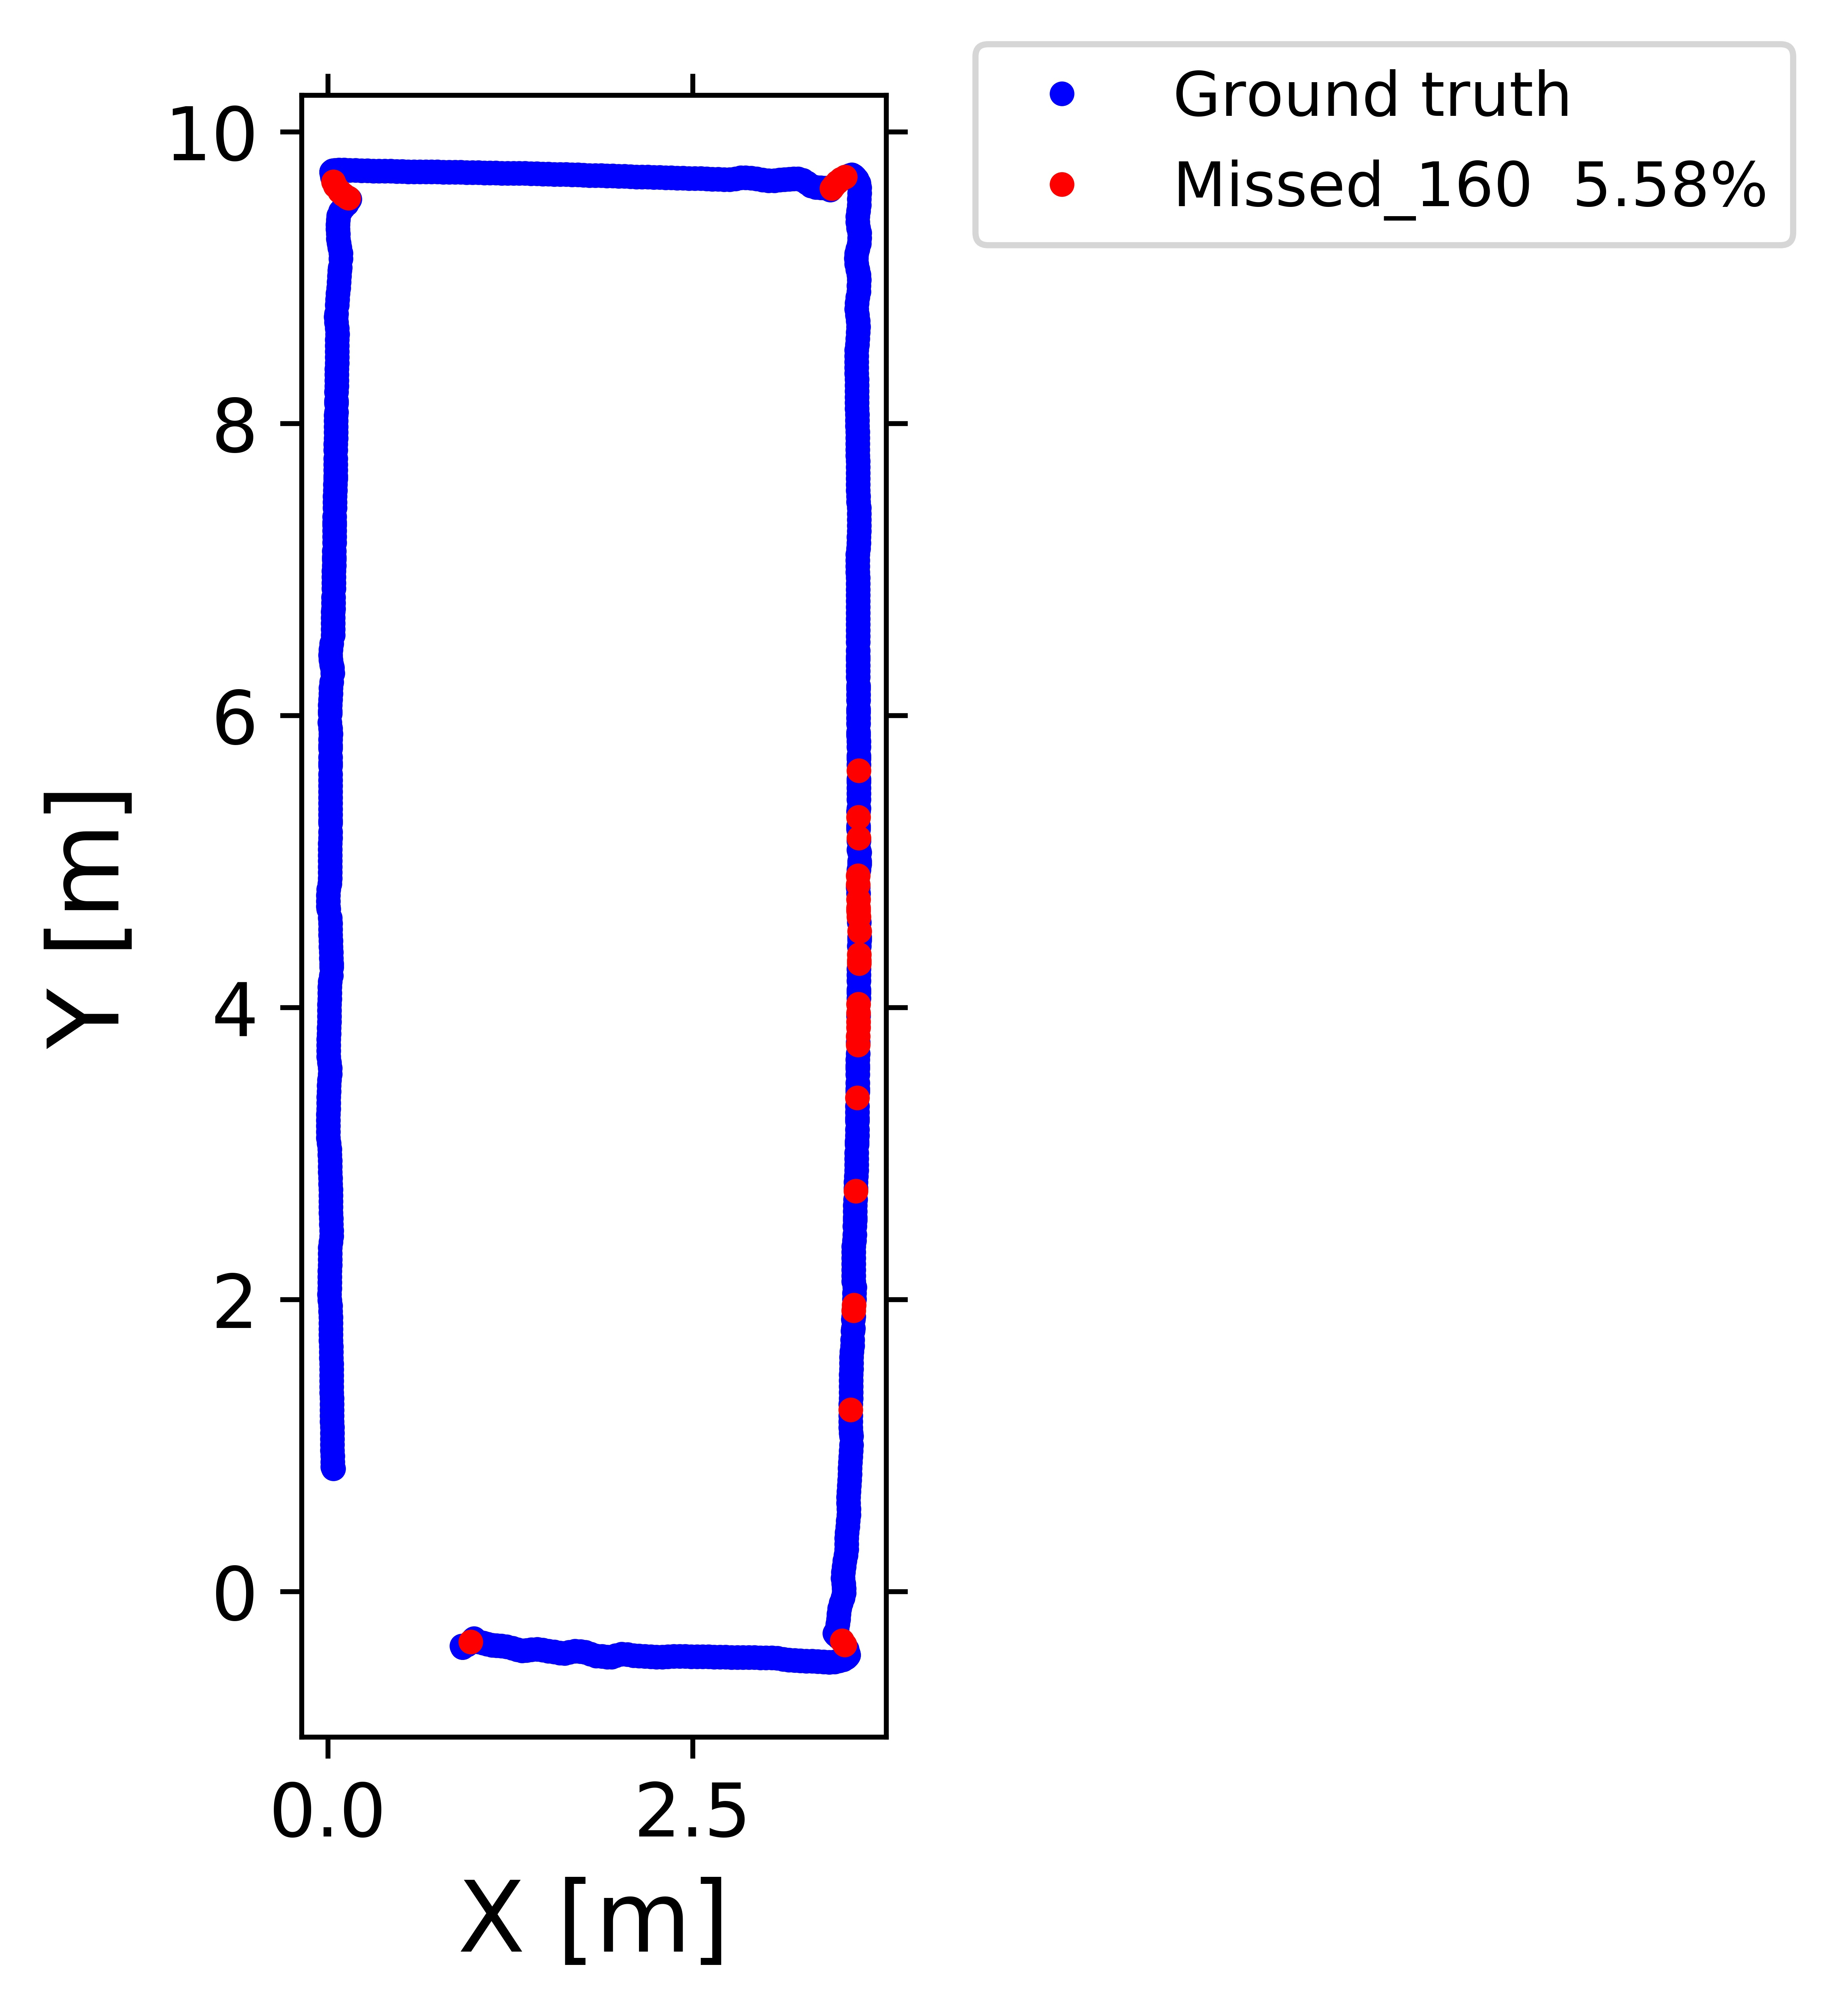
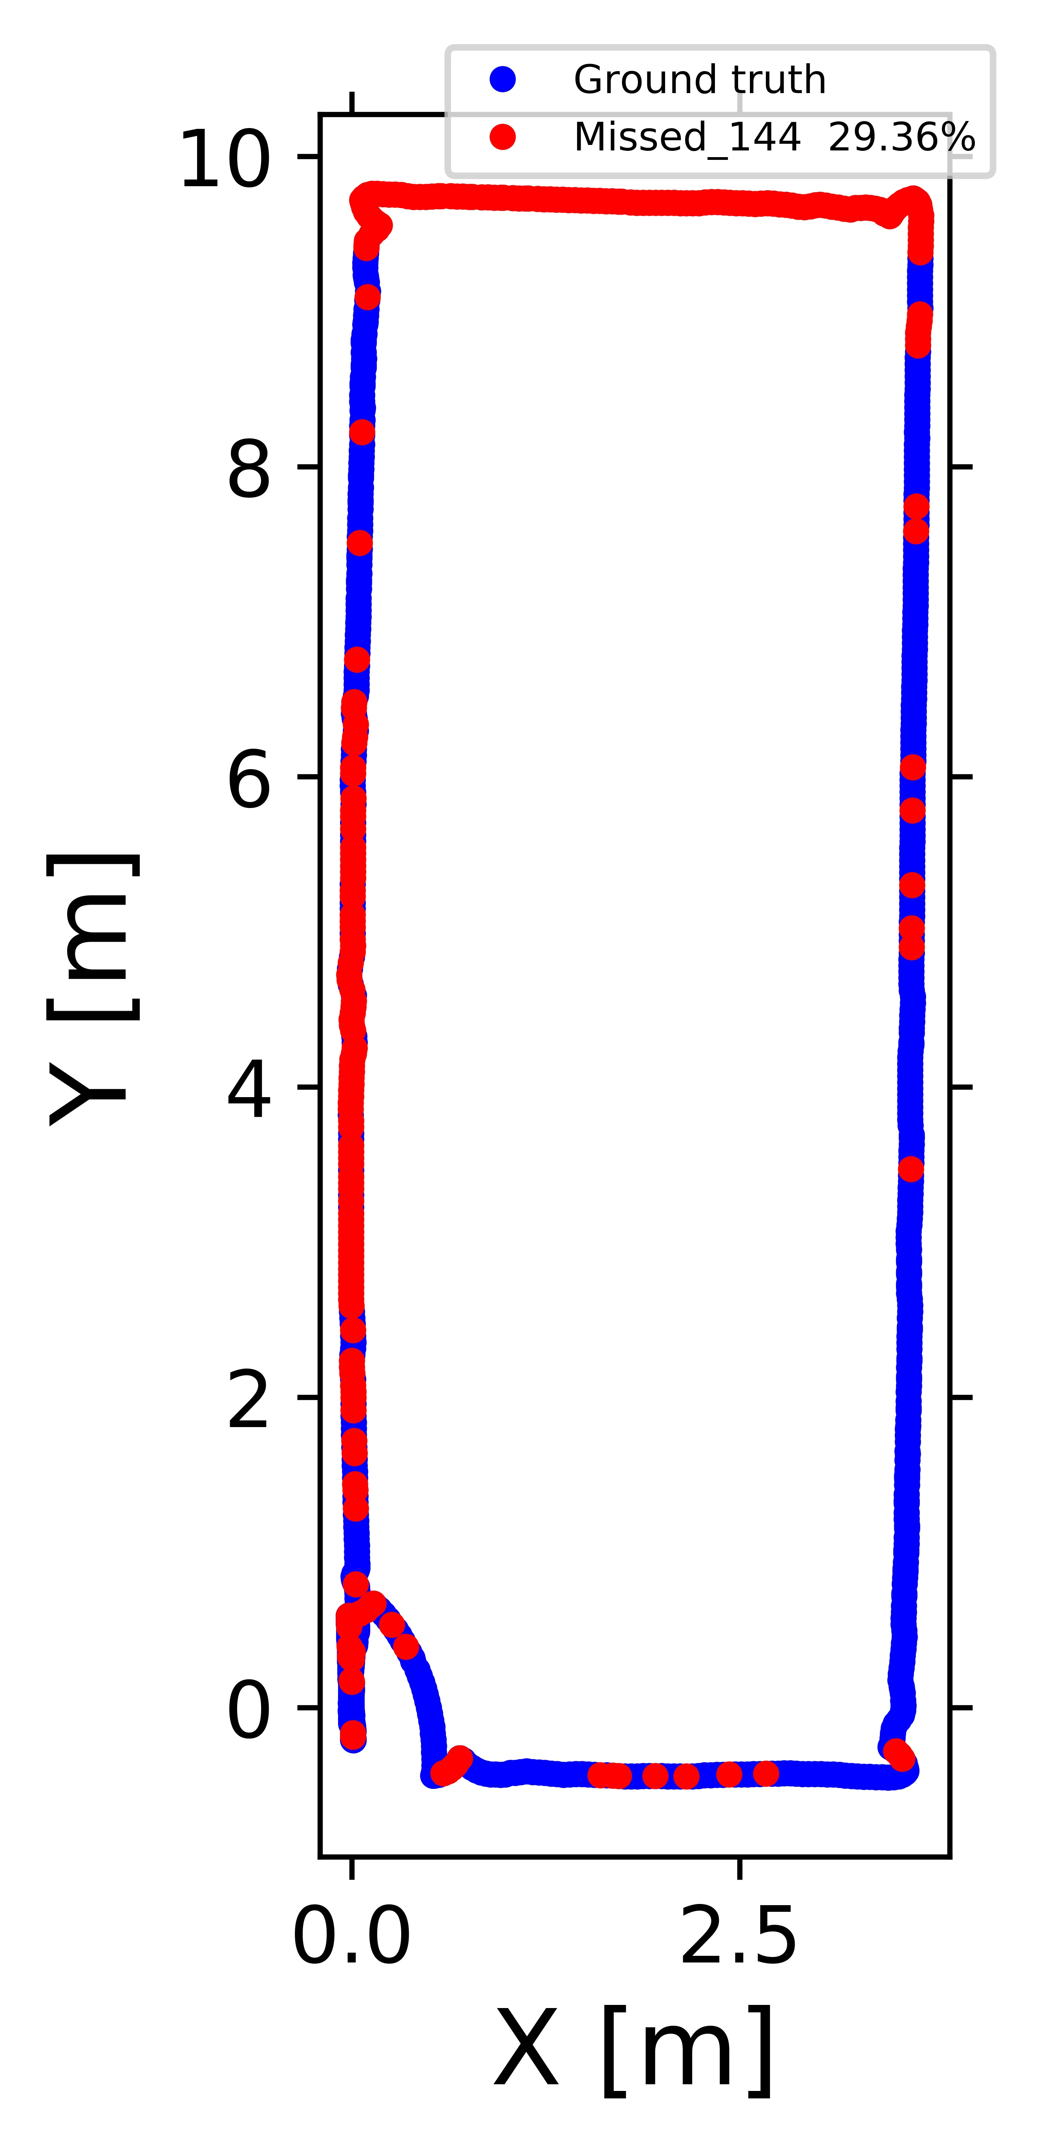
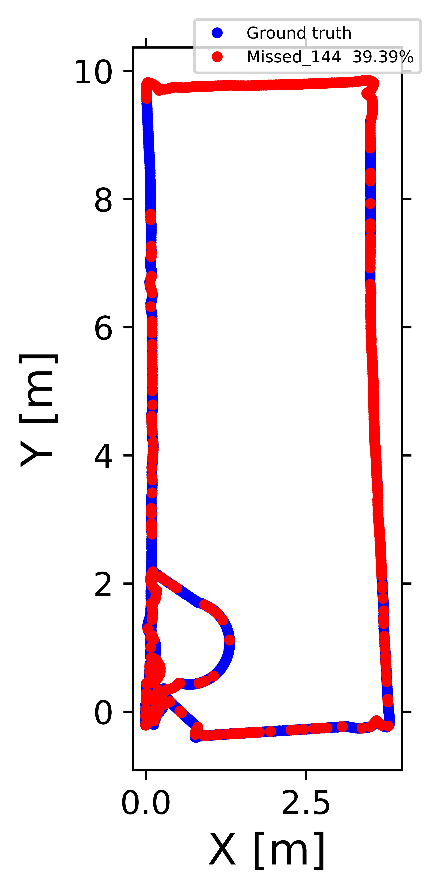
Test Data
Train Data
Real images total marker detection rate (indoor)
160
160
144
144

Slide 12
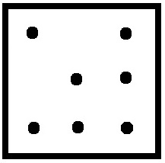
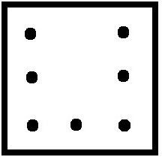
Challenges here
Train the model separately for each Aruco detection.
We Test the model separately for each Aruco.
In each image, either of one or neither one of them could be detected.
p(A and B) = ¼
This might be due to various reasons as explained in slide 4.
Aruco 160
Aruco 144

Slide 13
Evaluating Techniques
Just with Aruco 1 land-marker, 8 slow features.
Just with Aruco 2 land-marker, 8 slow features.
Concatenation of both the land-markers , with 16 slow features.
Average of both the land-marker features , with 8 sf.
Flagged concatenated features, with 16 sf and 2 detection binary values all together 18 values.

Slide 14
Scaling the data
Array Position
A_160
A_144
A_144
A_144
1
1
1
1
0.23
0.45
0.76
2
0
1
0.24
0.47
0.68
3
1
1
2
0.21
0.41
0.70
4
1
0
0
0
0
3
5
1
0
0
0
0
6
0
1
6
0.30
0.42
0.77
7
1
0
0
0
0
8
1
1
8
0.26
0.42
0.75
9
1
0
0
0
0
10
10
1
1
0.24
0.39
0.79

Slide 15
Simulated data individual Markers
Aruco 160
Aruco 144

Slide 16
Different techniques
Average of dataset
Concatenated
Concatenated - flagged

Slide 17

Thank You
Kaushik@stud.fra-uas.de
Notes:
<number>

